Slide 1
Creating Sonic Spaces
Vipin Chaudhary

Slide 2
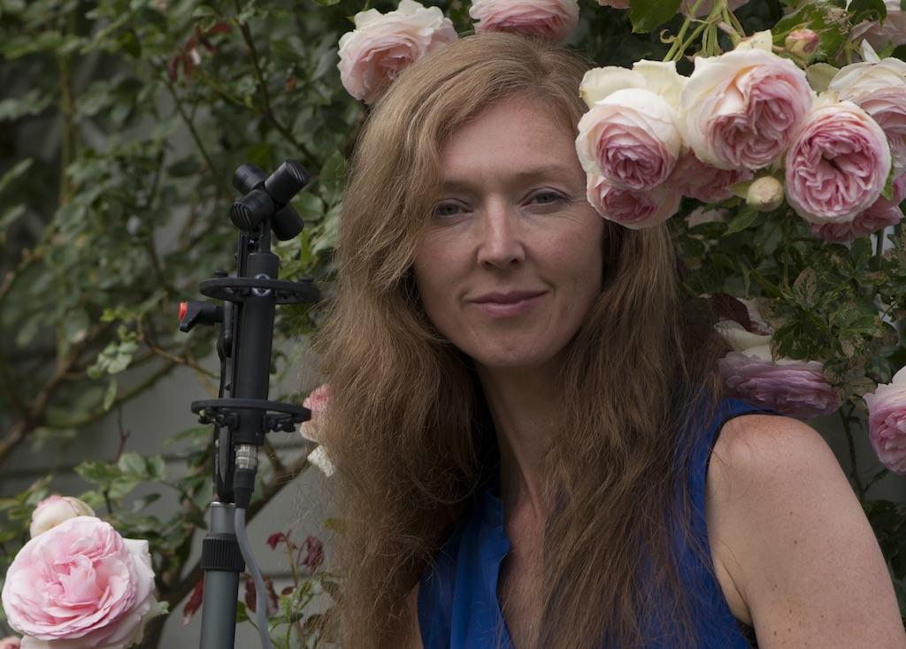
Who is Natasha Barrett ?
Natasha Barret is a freelancer composer who currently lives in Norway. Her compositional output consists of works for instruments and live electronics, sound installation, dance , theatre and animation projects.
She also received one of the most prestigious Nordic composer award i.e Nordic Council Music Prize in 2006
It was primarily focused on the composer’s thoughts on spatialisation.

Slide 3
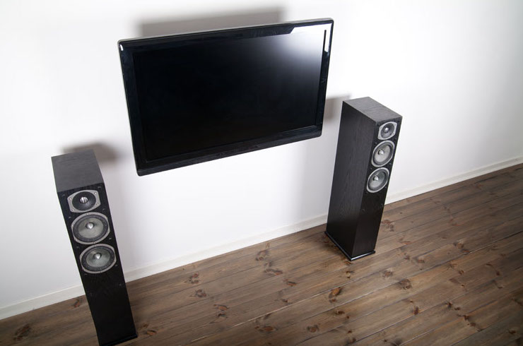
Impact of Space on Electroacoustic Music
it is hugely affected by our listening space
Close studio vs Open Concert for the impression of multichannel and multilayer sound
So in our example Simple room acoustic are quite stable spatial information but sense of perspective, occupation or embodiment are fragile

Slide 4
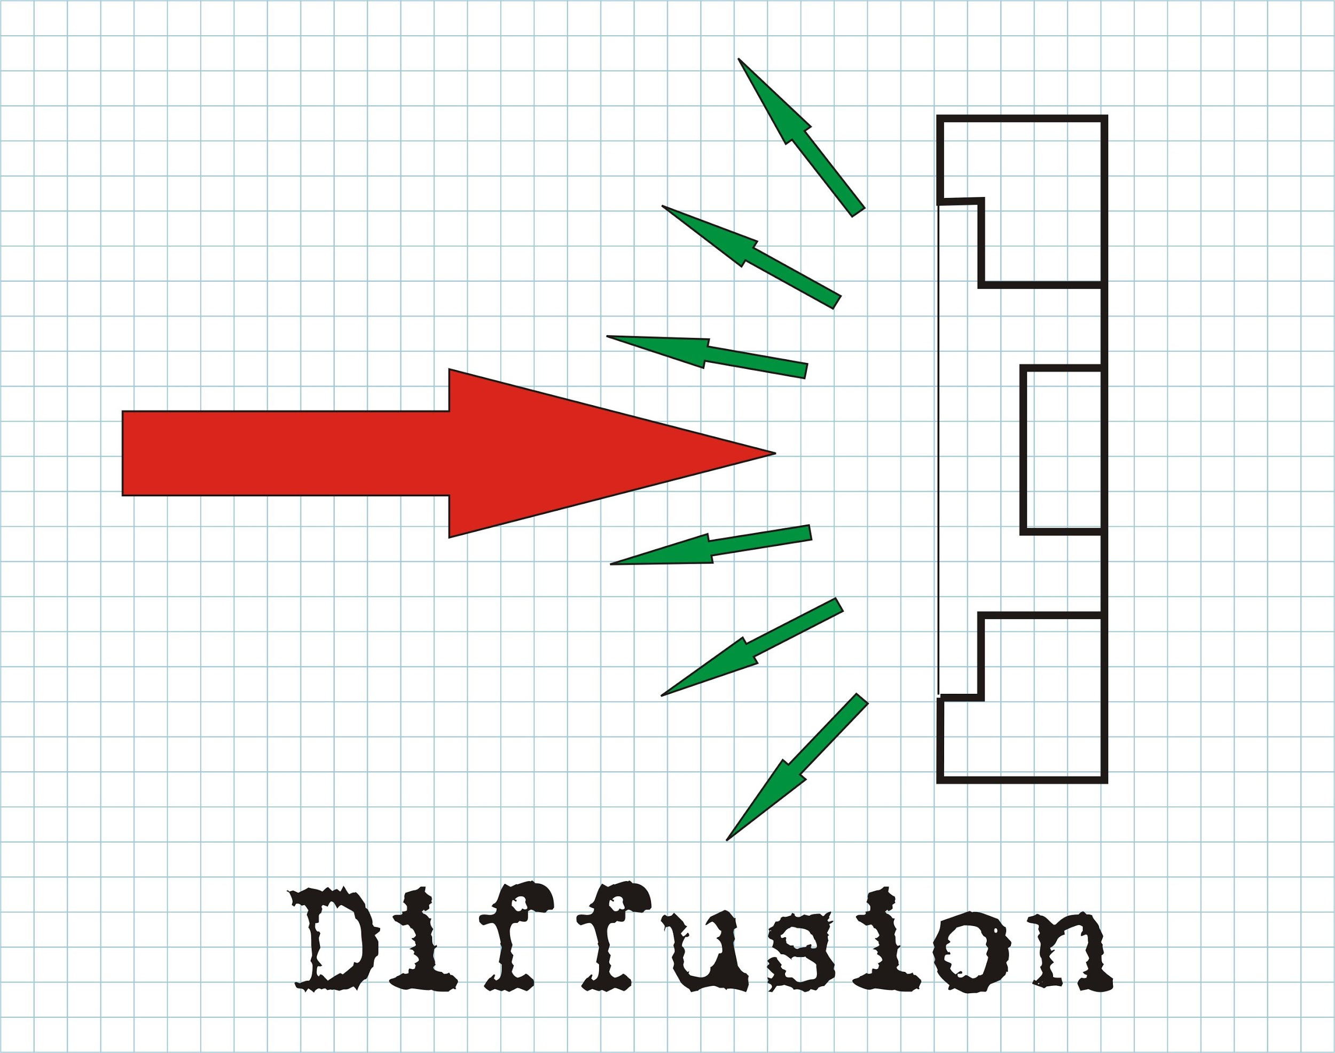
Sound Diffusion
Diffusion in acoustic if the effcacy by which sound energy is spread evenly in a given environment.
You can tailer the spatialization for a specific sound diffusion performance and make “not-so-good” piece sound fantastic and it can also destroy a piece if diffusion performance goes wrong

Slide 5
However with Ambisonics you can gain tighter control over spatial musical structure because you can accurately compose the spatial information and is not going to break in performance
Ambisonics can also result in concert disaster

Slide 6
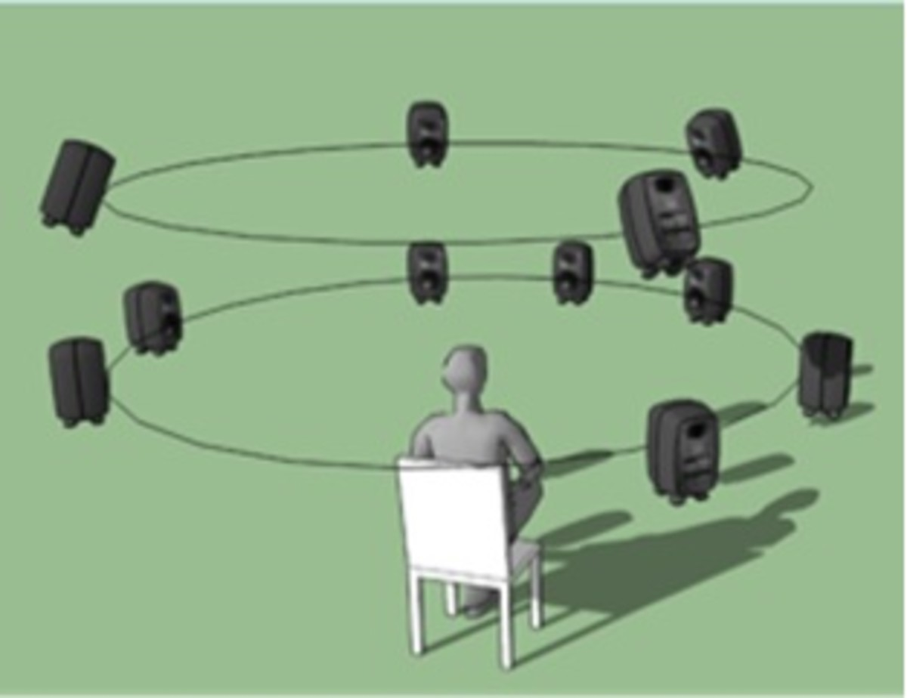
Ambisonics
There are 2 ways to create and manipulate a virtual 3 dimensional sound field : ambisonics and wavefield synthesis
Both will produce same result in a perfect world but have different different methods

Slide 7
It is use to capture or encode spatial information with the help of high order representation for accurate description
Each order corresponds to an order of spherical harmonics
Then the soundfield Information is decoded over chosen speaker arrangements
The higher the order of the encoding , the more loudspeakers are needed in the decoding.

Slide 8
Creating Spaces
Strongly connected to the experience of our surrounding
It is also very connected to the idea of allusion
Very tiny sounds can build up an impression of space whereas usage of abstract sound material can make it difficult for the listener to find the spatial context.
Reverberation can make a spatial context in starting but it will blur special details and messes up textural information
Whereas if you don’t use it they it may start with not so clear spatial context but as sound materials unfolds , its behaviour - the reaction between many things happening at once - imply space

Slide 9
Problem with Ambisonics
There are problems with the stability of the ambisonic sound field.
Because It is an encoding and decoding system where you encode the spatial information and decode results for the location of your loudspeakers.
You have to place speakers on the exact location for which you decoded which is very difficult to do because of the geometry of the hall
Current decoding algorithms do note cope well with asymmetry in loud speaker placements and responses
When loud speakers are different distance from the central point then phase problems can occur

Slide 10
Then the sound field will be distorted and will breakdown this will result in uneven sound distribution
So if it is a very reverberant space you don’t use ambisonics in that case diffusion can be used because you can control the piece better and adjust for the changes that happens due to sound moving in acoustic space
For 5.1 surround sound in ambisonics First Create the piece quad or stereo while listening in the perfect position

Slide 11
The End

